Slide 1
Green Recycle Bank
Emily Lomempow
Gandhi Arssegi
Yessy Anggraini

Slide 2
What is GRB?
So we are here as the team making this project, to make the reason why everyone should put the trash in the right place while helping make the better systems. By simple thing, encouraging. We will encourage people who put their trash in the right place by giving them rewards in form of points and will be accumulated for each person in the end to at least show them at least there are some meaning when you do something good and that is what the true rewards is. That is what GRB Project is, a system that encouraging people.

Slide 3
How This Project Works
System will turned on, then person (esp. dedicated for University of Indonesia community) can put the recycle able trash while input their identifier on the system. The system will measure the weight of the trash and save it to the the online system database based on the identifier. In there the weight will be calculated and accumulated into points to reward the id of person who put the trash. Finally the system will also send short message to person in charge if the trash on the garbage system overloaded.

Slide 4
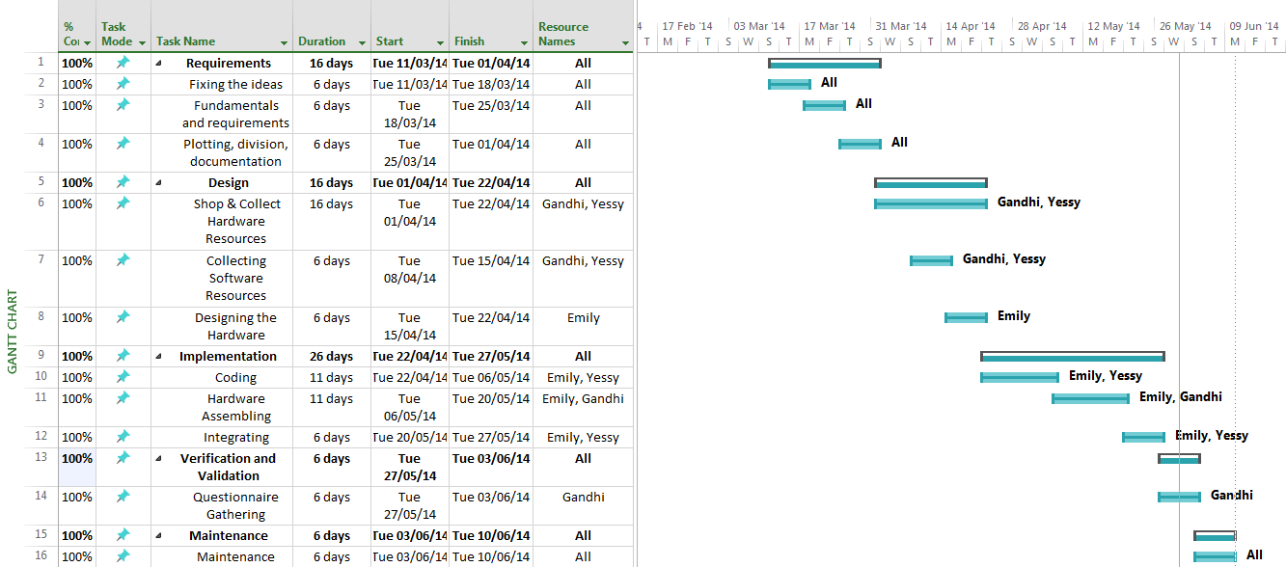
Timeline & Progress

Slide 5
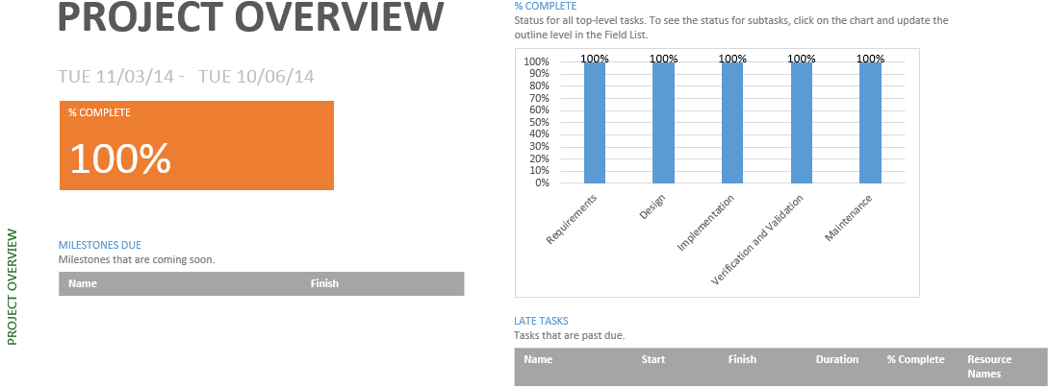

Slide 6
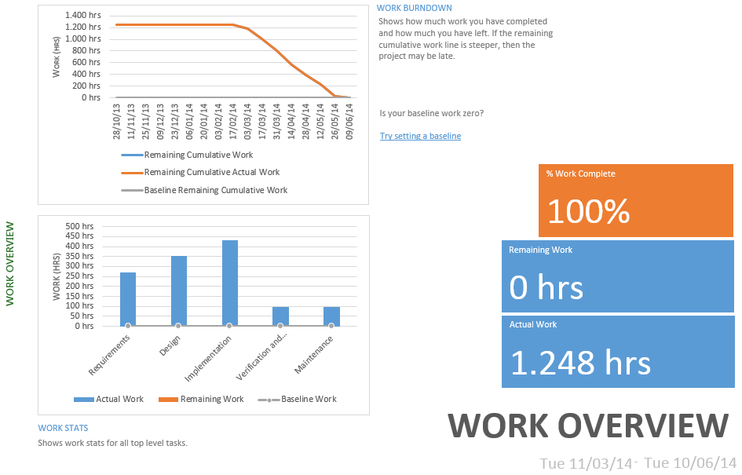

Slide 7
Code : (shown in Eclipse/ Arduino / notepad++)

Slide 8
User Manual :
Put the empty bottle to Green Recycle Bank
Green Recycle Bank will automatically calculate the mass
Input your name and NPM to the windows appeared
Click OK and the data will automatically transferred into database
Repeat first until forth steps to input another data
If total mass of the bottles reach the trigger (trigger can be modified),
system will send SMS automatically to the officer's number

Slide 9
Thank You.
http://learn.adafruit.com/force-sensitive-resistor-fsr/overview
http://www.digiwarestore.com/dw.php?p=search_result&keyword=sensor&method=contain&category=all&vendor=all&pg=24
http://arduino.cc/en/Main/arduinoBoardDue
http://www.ozekisms.com/index.php?owpn=168
http://git-scm.com/doc

